Slide 1


Racial Equity the Food System
Addressing Structural Racism and the Root Causes of Food Systems Inequity
Shorlette Ammons,
CORE Equity in Food Systems Coordinator
Center for Environmental Farming Systems
NC State University

Slide 2
Learning Objectives Process
Conceptualize
Practice
Understand
Share
Internalize
Notes:
Conceptualize – seek to understand the “who” thru stories behind the data and make clear who is impacted by food systems disparity by eliminating coded language such as “at risk”, “vulnerable”. Who are these communities and stating that clearly as a means to lead to shared understanding
Practice – a snapshot of how these systems are currently operating (thru policy and culture) and then sharing a couple of examples of processes that we are using to interrupt them
Shared understanding – really a recognition of these issues and they do indeed represent someone’s reality and that whole communities are impacted disproportionately (favoring/benefiting some and disparaging others), centering knowledge, experience, realities and expertise of people most directly affected and understanding the impact of racialized oppression on our food system; understanding it’s not exclusively race, but it’s always race
Shift the narrative to bring in these stories and realities of people who are impacted by food systems disparity and injustice
Internalize – shift policies, practices, procedures

Slide 3
Objectives
Define structural racism
Provide an introductory analysis of to how racism operates in our food system and who it impacts
Gain a perspective of what racial equity means for all of us, particularly those most impacted by food system disparity

Slide 4
Agreements
Purpose – to establish group norms as a means of modeling
1) Self-Determination 2) Shared Decision Making 3)Community of Practice
Be present
Listen Actively
Use “I” statements
Be fully present (silence cell phones)
Respect ourselves and others
Assume that everyone has a very good reason for feeling/saying what they do
Ask questions, seek to understand
Honor confidentiality
No quick fix and urgent (equity is a journey, not a sprint)
Be prepared for non closure (not in a neat package tied with a bow)

Slide 5
Share + Conceptualize
“Like so many southern farmworker children, I knew ‘where my food comes from’. We also knew that something wasn’t right.”

Slide 6
What’s Your Story…
?
?
Practice + Share + Conceptualize
Pair Share Activity
-Adopted from OpenSource Leadership Strategies
Notes:
Politicization –a) process of becoming politically aware b) realization that this is a political issue and therefore requires something of me (action)
Take 2 minutes (each) to discuss that moment with someone sitting near you. Popcorn share.

Slide 7
When was the first time you witnessed or experienced someone being treated differently because of their race?

Slide 8
What is your racial identity? When did you become your racial identity? How is that different from your ethnic identity?

Slide 9
Debrief…

Slide 10
Defining Racism
Race prejudice + Social and Institutional Power
A system of advantage based on race
A system of oppression based on race

Slide 11
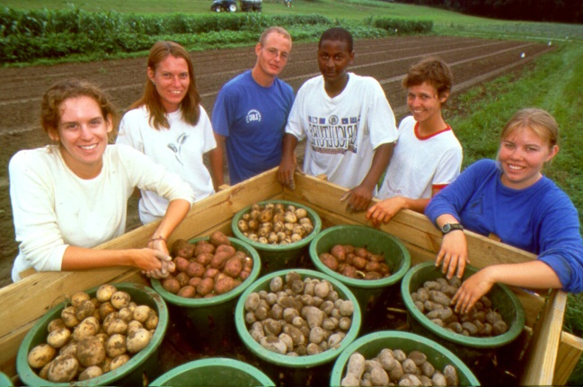
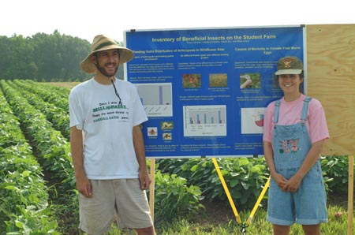
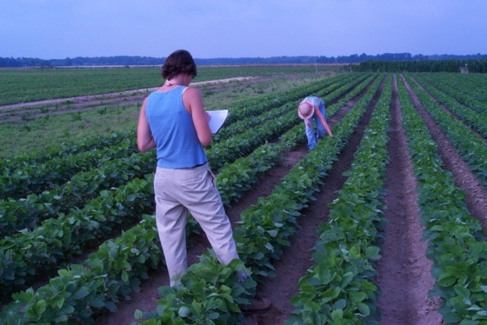
Center for Environmental Farming Systems [CEFS]
Practice
Mission: Develops and promotes just and equitable food and farming systems that conserve natural resources, strengthen communities, improves health outcomes and provides economic opportunities in North Carolina and beyond.
Partnership initiated in 1994
NC State University
NC A&T State University
NC Department of Agriculture & Consumer Services
www.cefs.ncsu.edu

Slide 12
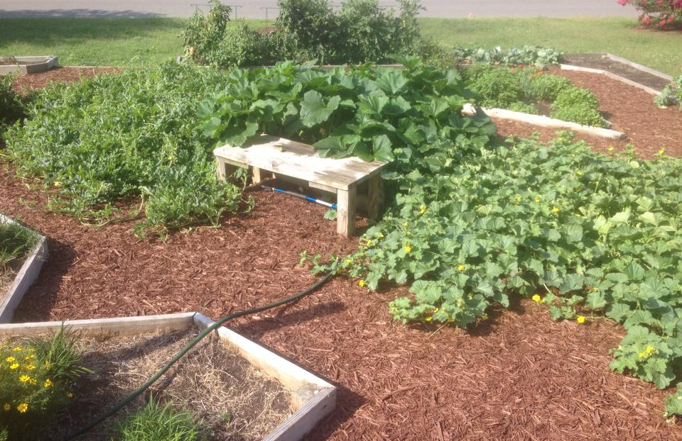
Library
Garden
Notes:
Reclaim public spaces; Exercising of intellectual freedom; celebrate difference thru food, advance understanding around racialized experiences

Slide 13
Racialization…
“the thing to remember about structural racialization is that racialized outcomes no longer require racist actors. It is built into the institutions and practices. Getting rid of a racist person does not change the practices. The critical aspect of racism that we must address today is the accumulation and incorporation of long-standing racialized practices into all of our social and economic structures." (p. 35)
-Grassroots Policy Project

Slide 14
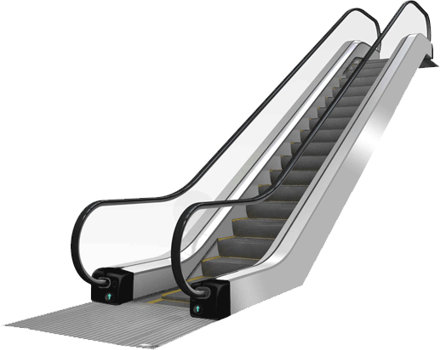
Why race?
Hierarchy of Human value
Notes:
Over the course of our shared history, race has been used to create a hierarchy of work, access and opportunity in the food system. The result over time has been division that amounts to lack of opportunities for those on the lower end of that hierarchy and benefits for those on the higher end. In the US historically, race has been one determining factor as to where people land on that hierarchy. Ultimately, the impact of racial division has been harmful to us all. There are other factors as well, such as economic status, gender, sexuality and ethnicity, just to name a few others. Acknowledging this reality up front helps us stay away from continuing that detrimental cycle and create new, inclusive patterns!

Slide 15
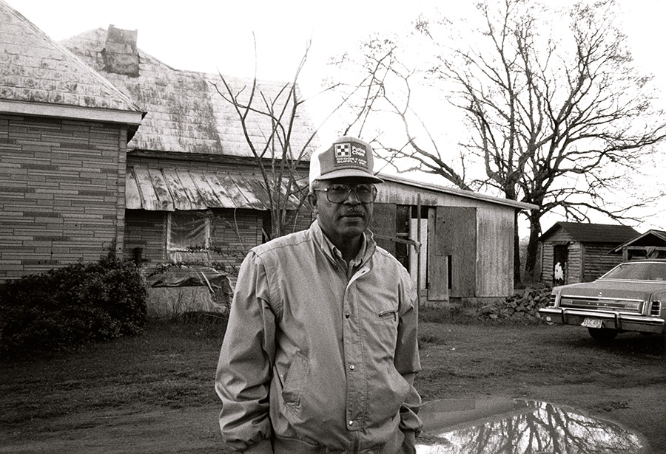
Pigford v Glickman
Class action lawsuit
400 farmers
Systemic discrimination by USDA
  Periods of 1983-1997
  PIGFORD vs GLICKMAN, 1998
  2008, $100 million settlement
  Additional $1.25 billion in 2010 (Pigford II)
Notes:
READ ALOUD – “John Boyd remembers watching a USDA official toss his loan application in the trash. It was the late ’80s, and Boyd, a fourth-generation black farmer from Baskerville, Va., was counting on a $5,000 loan to keep his family farm in business. Boyd was told to come back the next week to re-file his paperwork, but a white farmer walked out of the office with a $157,000 check.”
So an important piece of this, is the accumulation of these discriminatory practices over time – creating these inherit structures that make it easier for some people to just stand still on the escalator and move upward, while others are constantly trying to run up to the top of an escalator that’s going down.
By 1982, African-Americans received just 1% of farm ownership loans. The settlement provided two ways to seek damages: a fast-track process (Track A) that provided $50,000 plus loan forgiveness and offsets of tax liability, and a longer process (Track B) that required claimants to establish actual monetary damages caused by USDA discriminatory practices. The Track B process resulted in larger payments. As of April 7 of this year, a little more than $1 billion had been paid to 15,645 Track A claimants. About 6,900, or 31 percent of the claims, were denied.

Slide 16
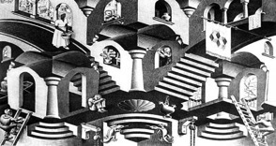
Structural Inequity
The ways in which history, culture, ideology, public policies,
institutional practices, and personal behaviors and beliefs
interact to maintain a hierarchy that over-advantages dominant identities and over-burdens or under-advantages “otherness.”
The cumulative impact of disparities in power OVER TIME.
What does that look like?
Concave and Convex by M.C. Escher
Notes:
Inequity is not about difference. It is not even about hatred. It is about the distribution of power.
We must distinguish between personal bias and the reality of living in a biased system – which we all do – and how that impacts us, both dominant identities and marginalized identities.

Slide 17

About
Practice +Internalize + Share
CEFS Mission:
CEFS develops and promotes just and equitable food and farming systems that conserve natural resources, strengthen communities, improve health outcomes, and provide economic opportunities in North Carolina and beyond.
Purpose of Our Equity Work:
The equity work of CEFS is a long-term commitment to work internally and collaboratively with community and grassroots groups to address root causes of food systems inequities and build collective solutions through the lens of structural racism as an entry point. Our approach begins with developing an understanding, analysis and shared language of impacts of structural racism in our food system. Our commitment is to be a part of this transformative process.
Notes:
So, now I want to show you how this intersects with the work and identity of CEFS. This is really about understanding our role in addressing racial equity in the food system as an institution and aligning it with our overall mission.
Understanding our role in the historical construction of the racial hierarchy (thru higher ed, ag and food systems work)
Acknowledging our role as gatekeeper and being an ally to communities most impacted by food systems disparity
Examing our policies, practices and procedures and working to make those more equitable

Slide 18
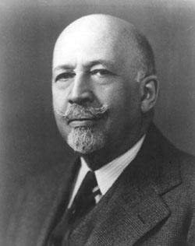
Development of Food-Based Cooperatives in the US
“we unwittingly stand at the crossroads—should we go the way of capitalism and try to become individually rich as capitalists, or should we go the way of cooperatives and economic cooperation where we and our whole community could be rich together?”
--W.E.B. DuBois
Notes:
We can look at history to teach us lessons on some alternative models and models of resistance. A means of community economic development in the Black community, aka “survival”. WEB DuBois said is was an alternative economic model to capitalism, because “capitalism has failed us {Black people}” around 1918. Also a strategy to combat the exploitation of black labor. To him, capitalism was about the dominant strategy of achieving individual wealth

Slide 19
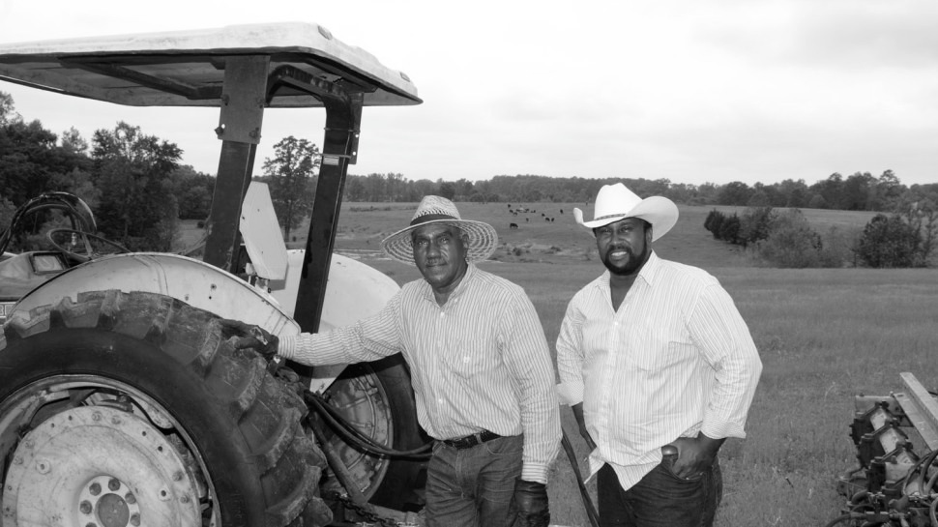
Black Farm Era
Rapid Decline of Black farmers and Black Farmland in the US
FARM OWNERSHIP
1910 - 218,000 Black farmers were registered as full or part owners of 15 million acres of land
1920 – 14% of US farms Black owned
1980s – less than 1% were Black owned
2007 - 28,000 Black farmers were full or part owners of 2.9 million acres of land.
Federation of Southern Cooperatives founded in 1967
Notes:
So to fast forward and further connect the dots to food systems…what was the economic driver for black communities during this period? Farming. In 1920 black farmers made up 14% of all farm operations in this country. So the cooperative movement was vital to ensuring the stability of black farmers (particularly in the South) and black farmland. DuBois also said, the problem of the 20th century is the “problem of the colorline”. Jessica Gordon who wrote a book called “Collective Courage” says that most people only focus on what DuBois names as the problem and don’t discuss what he offered as the solution, which is “cooperative economics”. So we see the Federation of Southern Cooperatives emerge and Black land collectives to combat this ongoing discrimination among black farmers that emerged out of the civil rights movement, many of which were black ag cooperatives.

Slide 20
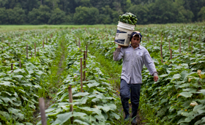
Food Insecurity among Farm worker Families
Over 70% of farm workers
are not born in US;
half are undocumented
Median weekly income for
farmworkers, $350
65% of US milk supply comes from farms that use migrant labor
Food insecurity numbers among farmworkers as high as 80% in some states
Poverty rate is twice that of all salary and wage employees
Notes:
“Life for immigrant workers in the food system is tough for many reasons—low wages, irregular working hours, dangerous working conditions, and increasingly, immigration enforcement measures that push unauthorized workers out of their jobs. Given the challenges facing laborers, many immigrants choose to start their own restaurants or open their own markets catering to the immigrant community.”
So when we talk about food insecurity and food systems disparity in general, we can’t NOT include the emotional and psychological toll on families and whole communities that impacts overall health, well-being and quality of life for folks

Slide 21
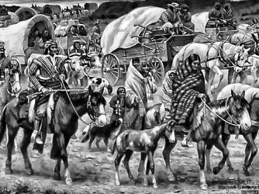
The Racial Hierarchy in Action:
Politically & Culturally - Then
Understand + Share + Conceptualize
Policy and Culture
“Right of Conquest” (1607-1732)
Three-Fifths Clause (1787)
Indian Removal Act (1830)
Education and Culture
Morrill Act (1860 and 1890)
Plessy v Ferguson (1896)
Brown v Board of Education (1954)
Notes:
A Snapshot of how institutions have maintained the racial hierarchy throughout history and a few areas of how communities have disrupted it.
Economic and Cultural impact of land policies
3/5ths clause - Northern and Southern states debate taxation, representation,and slavery at the Constitutional Convention in Philadelphia. In the final compromise, the United States Constitution decrees that individuals held in slavery will be counted as ‘three-fifths of a person.’
- Right of Conquest sets the stage for the Indian removal act – right of conquest and discovery, allowed for english setters to ‘discover’ lands already inhabited by native peoples. Spreading disease and violence with no legal rights;
It’s not to say all of these things were done with the INTENT of being harmful, but the IMPACT was harmful to many people of color in many instances and the IMPACT is lasting
Plessy v Ferguson - Supreme Court rules that 'separate but equal' facilities for people of color are valid under the Constitution. The ruling opens the door for Jim Crow laws and racial segregation in every aspect of public life.
Brown v Board of Ed: Supreme Court rules that racial segregation in public schools violates the Constitution. The next year the Court orders that desegregation occur "with all deliberate speed."

Slide 22
The Racial Hierarchy in Action:
Politically & Culturally - Now
Pigford v Glickman (1960s) → Black land loss
Redlining (1930s) → Now
Immigration Legislation (1920s) → Now
Notes:
Black landloss - In 1920, 1 in every 7 farmers was black; in 1982, 1 in every 67 farmers was black.
In 1910, black farmers owned 15 million acres of farmland; in 1982, black farmers owned 3.1 million acres of farmland.
In 1998, a lawsuit was successfully filed against the US Department of Agriculture on behalf of black farmers who had for decades been denied loans and other assistance that had been routinely extended to white farmers. Today, there are fewer than 18,000 black farmers, representing
less than 1% of all farms in America.
1929: The U.S. government deports thousands of Mexicans, including U.S. citizens, to Mexico during the Great Depression. A year later Mexicans are classified separately on the census to limit their immigration and reinforce the idea that they are not white.
- 6 of every 10 farmworkers are undocumented immigrants; 63 percent of migrant and seasonal farmworkers were food insecure,
with almost 35 percent experiencing hunger.
1930s redlining – intentional disinvestment of certain communities. Evidence during housing policy in the 1930s. Focused on lending practices of banks to invest in the growth and development of white neighborhoods over predominately POC neighborhoods and we see that practice today in grocery stores—where they redline out of communties of color, limiting access to quality healthy food and quality food systems jobs

Slide 23
What do we mean by Equity?
An equitable society would be one in which there are improved outcomes for all.
Using an Equity Lens means to:
Acknowledge the presence of structures that shape life options and outcomes.
Analyze the impact of structures on a specific issue, condition, or population.
Develop structural strategies to interrupt inequities and improve outcomes and opportunities for all.
Repeat…
Courtesy: OpenSource Leadership Strategies, Inc.

Slide 24
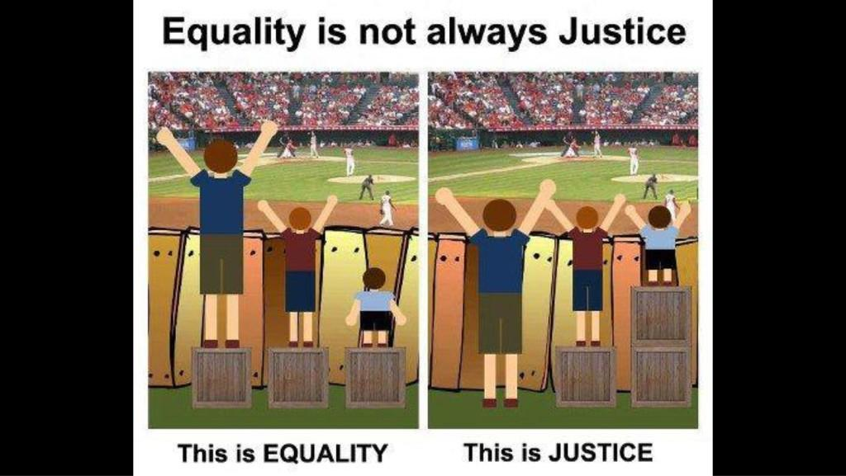
What do we mean by racial equity?
EQUITY
“…is the FLOOR beneath which no one should fall.”
-Maya Wiley
Race or zip code no longer determines health outcomes or how or if people will have access to economic opportunity.
Notes:
Food equity then refers to the dismantling of structural, systemic and institutional barriers that prevent all people from having fair and equal access to healthy, affordable, culturally appropriate food. Including structural racism. Structural racism refers to the systemic factors that sustain racial inequities and this is directly linked to social, political and economic policies, practices, and procedures. (ex. WIC program).

Slide 25
Try it On…Equitable Framing
What does EQUITY look like?
Community-organized and community-driven
Collective/collaborative
– focused on building
alliances
Focused on long-term
strategy
Benefits all

Slide 26
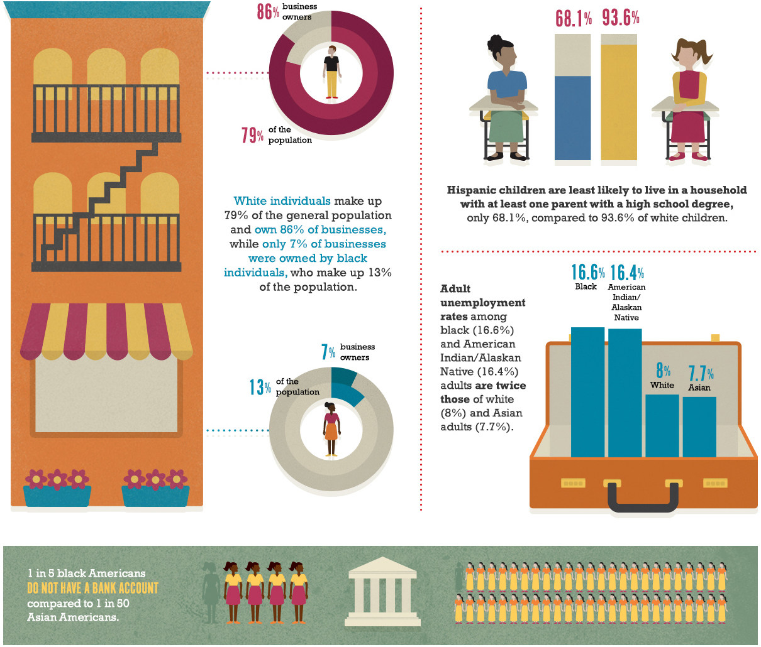
*8 million MORE poor white people than Black; 5 million MORE poor white than Latino
Why Race?
Notes:
Why race? It’s not exclusively about race, but it’s always race.
Color of Food Report

Slide 27
OUR Process
Independent assessment of how structural racism affects our team and work
Growing circle of stakeholders to make meaning and build capacity for Racial Equity work
Convene internal Racial Equity core team
Expertly facilitated dR training for core team and others
In-Between Study groups (regular and continuous)
Notes:
1) establishment of an internal “core team” made up of diverse and inclusive representation from CEFS leadership, researchers, Extension, youth and outreach staff 2) facilitated training on dismantling racism for our core team to develop a shared language, understanding and analysis around food systems inequities using the lens of structural racism 3) survey, research and analyze how structural racism affects our food system, organization and our team itself 4) convene to assess what was learned and gathered from the process thus far and 5) strengthen capacity and engage stakeholders and staff around this process. Check-in, study and discussion group sessions will be held throughout, facilitating opportunities to engage each other as we build a collective process. An evaluation of our organizational dynamic was helpful in unveiling the need to intentionally begin our work internally as a means to better understand our power and privilege as an institution of “higher learning” as we begin to transform how we work alongside our community partners.
The next phase of our work will involve ongoing engagement with community partners to build genuine relationships in order to co-create strategies that will address root causes of food insecurity and increase access to healthy food and opportunities within the food system, particularly for youth of color.

Slide 28
Thank you
Shorlette Ammons
Center for Environmental Farming Systems
www.cefs.ncsu.edu
sammons2@ncsu.edu
Notes:
Thanks yall ☺

