Slide 1
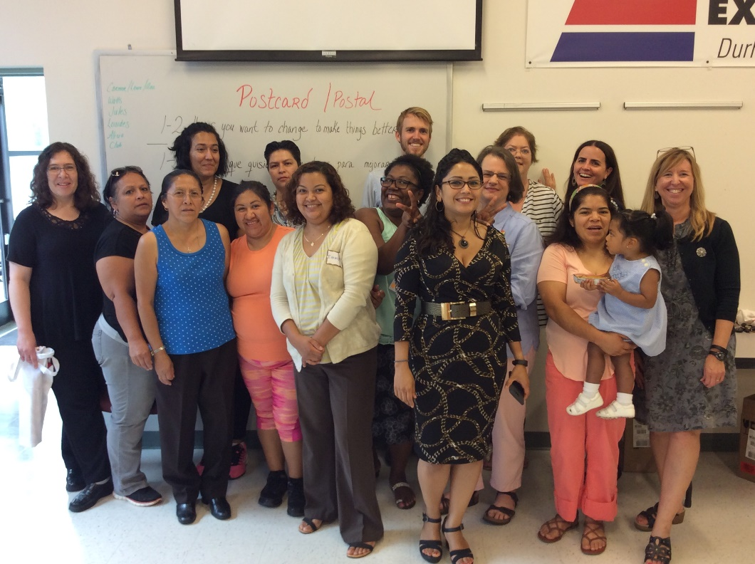
Parents As Leaders (PAL): Strengthening Latino Parent Leadership and Advocacy in Our Public Schools
Donna Rewalt, NC Cooperative Extension
Durham County Center
Community Development
drewalt@dconc.gov
(919) 560-0538
May 3, 2017
Notes:
The school environment is complex and often difficult to navigate for parents in general. Spanish speaking/Latino parents experience additional challenges.

Slide 2
ABOUT PARENTS
Parents are PEOPLE
Parents have Barriers
Parents bring their own school
experiences
Parents cross many generations
Parents are diverse
WHO is a PARENT Anyway?
Notes:
Takes an active role in a child’s life—biological or not, aunt, friend, etc.
YOU are Building relationships with parents and their student(s)
ASK—What do they already know? Build from here.
LEARN—about them and their goals for their child
LISTEN—hear their experiences and concerns
DON’T ASSUME—that they already know things about helping their child
PROVIDE INSIDER INFORMATION—share what isn’t being shared with them
BUILD Trust

Slide 3
BACKGROUND: Getting Started
2003—Developed Parent Advocacy Training (PFAST)through a community process and partnership to help improve student achievement and close the academic achievement gap.
2005—Cooperative Extension developed grant to fund work (PFAST) and hired staff person.
2006—Developed next step leadership training (PAL).
2007—Spanish Advocacy Training (PFAST).
2015—Leadership Training in Spanish.
Notes:
May appear to only deal with navigating schools, has application for 4-H, FCS, Local Foods, Ag/Hort—partnerships and capacity.

Slide 4
Parent Family Advocacy and Support Training (PFAST) and Latino PFAST (LPFAST)
are six-session advocacy trainings for parents, family members or other involved adults who want to learn how to help their child achieve and better navigate the public schools. LPFAST is offered in Spanish. From evaluation data, we know that parents who participate in PFAST are…
Better connected and know better how to access resources.
Develop greater competence and confidence in communicating with their school to help their child.
More knowledgeable about key school topics.
Notes:
PFAST was also early foundation for the Juntos Program
PFAST is participatory and can be done in schools and in the community.
Mention topics—communication, parent involvement, standards and testing, Exceptional Children, moving to action
Spanish-speaking parents share what they have learned with their networks and often want to take the training more than once to learn and be with other parents.

Slide 5
The NEXT STEP
Developed Parent Leadership Training—Parents As Leaders (PAL) Academy—for parents who want to advocate beyond their own family/child.
PAL moves parents from self-advocacy to school and community leadership.
Originally developed in English.
Recognized need for Spanish translation and additional support for a pathway to leadership for Spanish-speaking and immigrant families.

Slide 6
ProbLEM Statement :
Just over 13% of the Durham population is Hispanic/Latino, yet 24% of the children in Durham Public Schools are Hispanic/Latino. Despite the number of Latino students, the school system, its structures, and decision-making processes have yet to fully engage these families in the education of their children and include them in the fabric of the structures of the institution. Latino parents may attend school functions and receive translation, but few are engaged in decision-making and leadership.
Notes:
Additionally, parents of Latino students in public charter schools have even fewer avenues for access and participation. This project intends to develop the leadership and advocacy skills of Latino parents and address informal and formal structures for decision making, School Improvement Teams, PTA, and School Board participation. As parents and school staff must work together across cultural lines, this project also addresses the needs for cross-cultural relationship development with other parents and staff.

Slide 7
PARENT ENGAGEMENT Core Beliefs
Core Belief #1
All parents have dreams for their children and want the best for them.
Core Belief #2
All parents have the capacity to support their children’s learning.
Core Belief #3
Parents and school staff should be equal partners.
Core Belief #4
The responsibility for building partnerships between school and home rests primarily with school staff, especially school leaders.
Source: Beyond the Bake Sale: The Essential Guide to Family-School Partnerships
Notes:
Equality of partnership is difficult with language and cultural difference.
Partnership equity difficult to achieve with language differences, often have to ask for access

Slide 8
PTA National Standards for School and FAMILY Partnerships
Standard 1: Welcoming all families into the school community
Standard 2: Communicating effectively
Standard 3: Supporting student success
Standard 4: Speaking up for every child
Standard 5: Sharing Power
Standard 6: Collaborating with community
Notes:
Parents access to partnership and sharing power leading them toward leadership and community collaboration.
For parents to lead, there must be some sharing of power.
(Schools/teachers receive little education about working with families.)

Slide 9
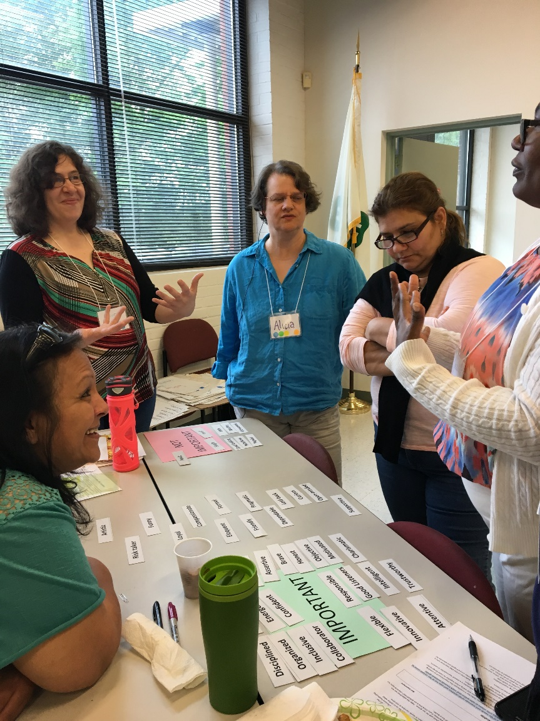
PAL COMpoNENTS
3 full day sessions
Leadership Development
Key School Topics
2 Field Trips
One School event, SIT, or
other event.
One School Board Meeting
Project
Group or Individual
Must work with others
Move from Issues to Action
Notes:
Offered in English and Spanish
Theory of creating a multilingual space, relationships
Leadership Session Dates
All Sessions include a meal and childcare. Locations will vary in schools and the community. We request attendance at all sessions. Participants can miss up to one session and still complete the Academy. We will provide make up materials.
Saturday, April 23, 9:00-2:00
Saturday May 7th 9:00-2:00
Thursday, June 2, 5:30-8:30 or possibly Saturday May 21st 9:00 – 2:00
Graduation Picnic—June TBA
Fall Project Meeting—Date TBA (Have a speaker, share about projects, reconnect for new school year)
Do real colors, School structure and finance

Slide 10
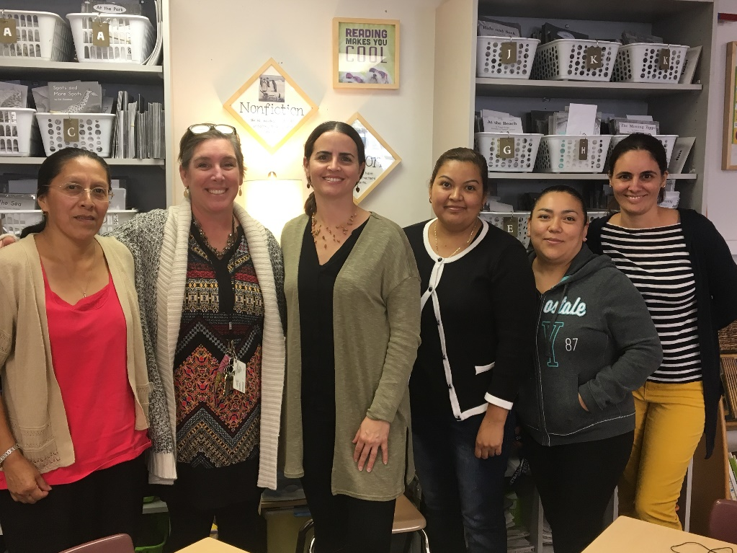
PROJECTS!
Examples:
Latino Parent Welcome Events
Recruiting Families/Neighborhood Canvass
Resources for Transgendered Students
Free SAT test preparation
Notes:
Talk about outcomes.
Leading to partnerships.

Slide 11
AdvantaGes of Partnering with Schools
Build capacity & community of parents
Change school dynamics
Parents improve connection with their school
Work with school personnel directly
Move parents into school leadership
School collaboration with trusted community group builds credibility & trust with parents

Slide 12
CHALLENGES
TIME
PLANNING
OTHERS WHO ARE WILLING
TRAINING
AMOUNT OF EFFORT
IS DEVELOPING PARENT LEADERS WORTH IT?
Notes:
Changes in school leadership– example, did leadership training in two schools, BOTH principals left
Transform public schools

Slide 13
Anticipated Long-term Results
1) Expanded relationships of Latino parents with school- and district-level staff and other parents from diverse cultural backgrounds. Relationships are a building block for parent leadership.
2) Increased leadership of Latino parents in PTAs and other parent organizations at the school level and in the community. Latino parents often attend PTA and other events, but are less likely to be leaders of these activities or members of the committees and structures that create them.
3) Improved access to decision making venues at the school level increasing leadership and participation in School-level decision making teams. School Improvement Teams (SIT) create the school's improvement plan, develop strategies, and monitor progress, and rarely have Latino parents participating on these teams or giving meaningful input.
4) Regular engagement and participation of Latino parents and families in the work of the DPS Board of Education and in the Boards of Durham's charter schools.
Notes:
100% of parents gained at least skills and knowledge.
Impact individual parent and systemic change within system

Slide 14
LESSONS LEARNED
Create a bilingual space when possible.
Hearing from community leaders participants can relate to is impactful.
School leadership can make or break efforts.
School interest and investment matters—Transformative Schools vs. Transactional Schools.
Look to ESL programs, work with individual schools/programs.
Take risks, innovate, and prepare to fail.
Listen to and learn from the parents. Let them co-create the experience.

Slide 15
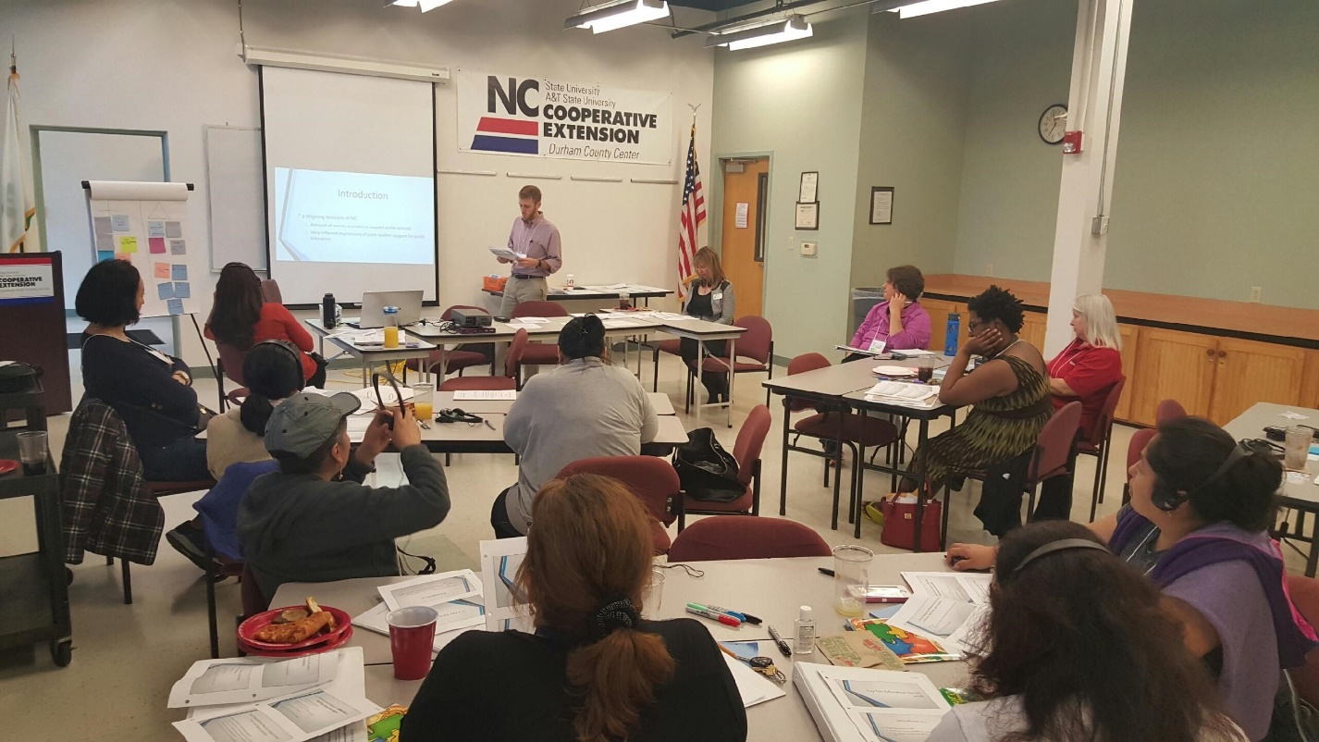
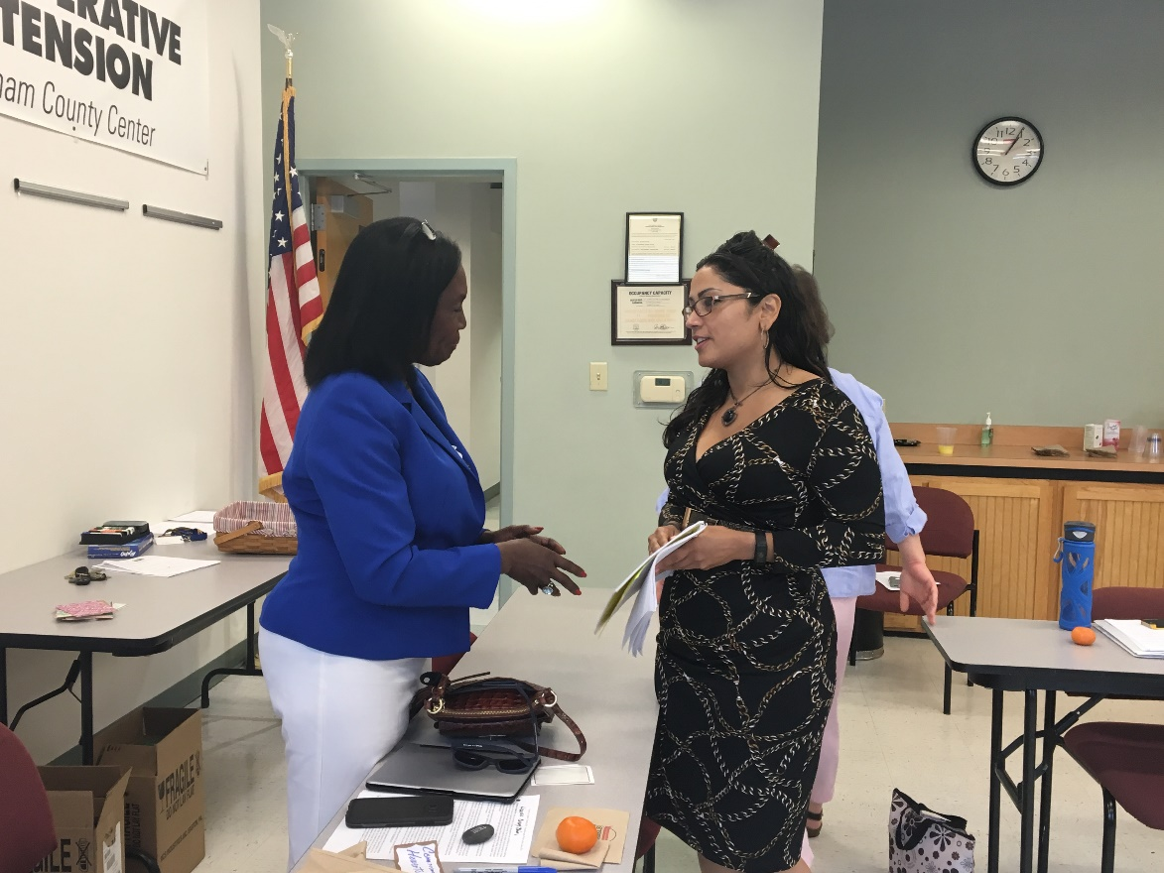
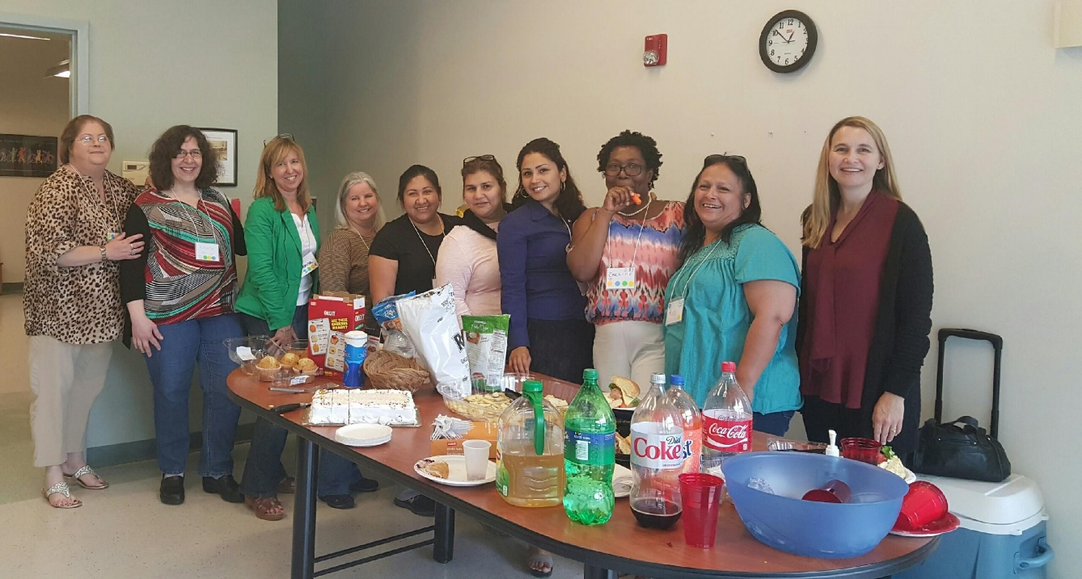
NEXT STEPS

