Slide 1
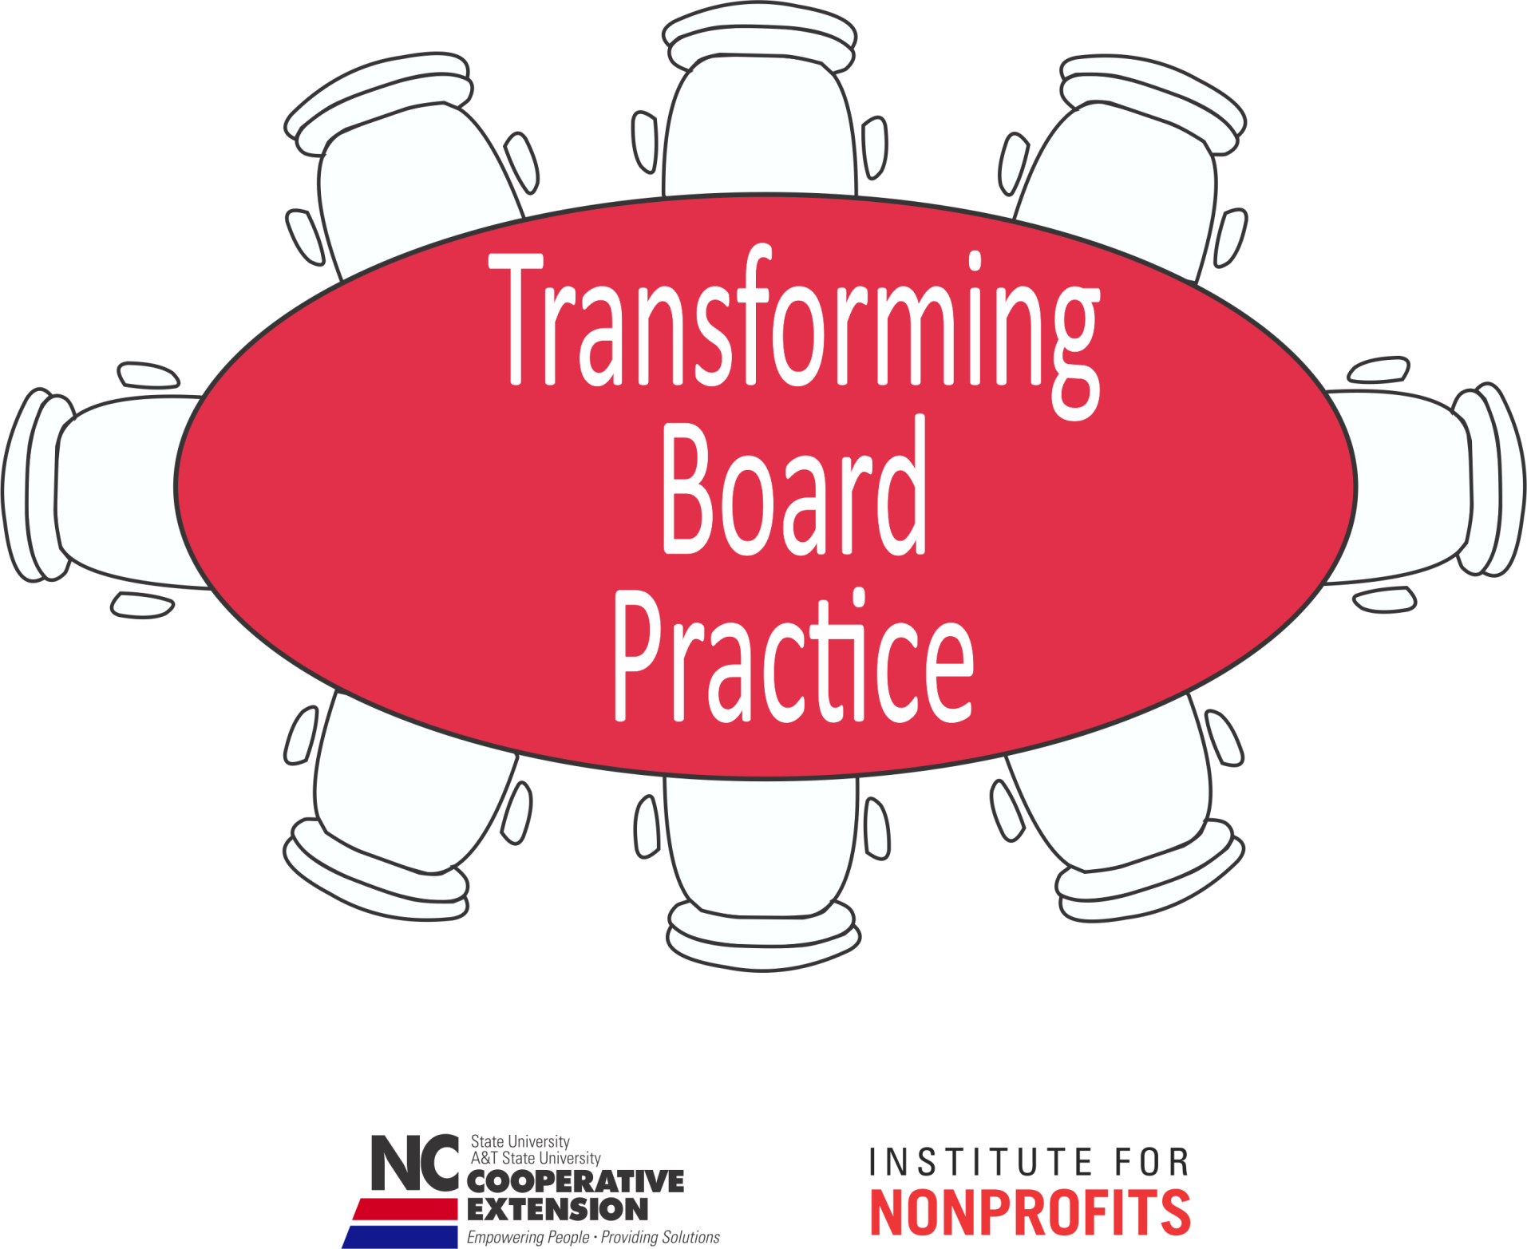

Slide 2
Becky Bowen She is an attorney and has served several nonprofit organizations in various capacities, including communications director, general counsel and executive director. She currently is a Co-Director of Carolina Common Enterprise, a nonprofit cooperative and community development center.
Jessica Katz Jameson is an Associate Professor in the Department of Communication at NC State University. She teaches courses and conducts community-engaged research on the topics of organizational communication, conflict management and nonprofit leadership. She chairs the Academic Council for the Institute for Nonprofits and serves on the Extension, Engagement and Economic Development task force for the College of Humanities and Social Sciences.
Susan Scherffius Jakes is the Associate State Program Leader for Community Development, an Extension Assistant Professor with NC Cooperative Extension and an Adjunct Professor in Psychology at North Carolina State University. She received a Ph.D. in Community Psychology from North Carolina State University.
Mary Tschirhart is a Professor of Public Administration at The Ohio State University. She served as Director of the Institute for Nonprofits and Professor of Public Administration at NC State University from 2008-2013. She has published extensively on nonprofit topics including board governance. She recently co-authored a text titled Managing Nonprofit Organizations. Dr. Tschirhart has served on six nonprofit boards in a variety of roles, including president, and led a nonprofit as its executive director.

Slide 3

Module 8
Board Meeting Communication

Slide 4

Goals for this Module
Participants will be able to:
  Identify common meeting obstacles, explain why they happen, and identify strategies for minimizing them
  Create engaging agendas that foster brainstorming & deliberation
  Practice consensus decision-making processes
TBP

Slide 5

Communication “Pitfalls”
Attribution error
Focus on individual goals
Defensiveness
  Threatening others’ “face”
  Saving (our own) face
Poorly Expressed Strong Emotion
TBP

Slide 6
Pitfall #1: Attribution Error
Attributions are explanations we make for our own and others’ behavior
We often blame others’ “bad” behavior on internal traits rather than external causes
Our errors are based on previous relationships
and impact future interactions with others
TBP

Slide 7
Responding to Attributions
Recognize the attribution you are making; you do not have to act on it
Respond to the issue, not the behavior
TBP

Slide 8
Pitfall #2: Individual Goals
Board members have multiple goals & expectations related to:
Content
Relational
Identity
Process
TBP

Slide 9

Responding to Individual Goals
Balance individual interests with the common organizational goals
Refocus the group on the organization’s vision, mission, and values
TBP

Slide 10
Balancing Individual & Group Goals
Someone raises a point or issue that is irrelevant to the agenda item:
  Validate the person
  Does it support the mission?
    If yes, redirect to another place/time
    If no, respectfully make boundaries clear
“We have limited time to meet our goals for this meeting; I would like to get together to talk about that another time.”
TBP

Slide 11
Pitfall #3: Defensiveness
Think about how you feel when someone says….
  “These ideas will never work, we have tried them all before.”
  “We are all frustrated that we have failed in the past; how can we think about this differently?”
TBP

Slide 12
Defensive & Supportive
Communication
Defensive
Evaluation
Control
Strategy
Neutrality
Superiority
Certainty
Supportive
Description
Problem orientation
Spontaneity
Empathy
Equality
Provisionalism
TBP

Slide 13
Communication Pitfalls
Practice Activity
A board member comes to a meeting very excited about a conversation they just had with a potential donor.
The donor is willing to make a fairly significant donation if your organization will collaborate on a project with another nonprofit.
The relationship between your mission and the other organization’s mission are not immediately apparent.
TBP

Slide 14
Pitfall #4:
Poorly Expressed Strong Emotion
Passion is a double-edged sword for nonprofit boards
Engagement Intensity
TBP

Slide 15
Intense Language
Imagine hearing the following statement in a raised voice:
“How could you possibly think
that is a good idea?
Isn’t it our mission to serve
this community in an ethical
way?”
TBP

Slide 16
Intense Language
1. What emotion(s) do you think the speaker is feeling?
2. What does the speaker need to feel better and to engage appropriately?
TBP

Slide 17
Reframing Intensity
  Validate the speaker
  Validate the underlying issue or concern
  Remind the speaker of the need for collaboration
  Re-state the concern using supportive communication
  “You are reminding us of really important points and I can tell you feel strongly about this. Thank you for bringing us back to our mission…”
TBP

Slide 18

Preventing Pitfalls
Board Development
  Communicate expectations
  BOD manual
  Communication training
Provide opportunities for social interaction to build climate of trust
Create agendas that allow for participation so all members feel included
TBP

Slide 19
Agendas that Support
Generative Governance
Consent agendas
Recap purpose of meeting
(3) Start with ritual to get everyone engaged
(4) Place fewer items on the
(5) Start each item with a question
(6) What haven’t we thought of?
TBP

Slide 20
Building Agendas that Support
Generative Governance
What does a “typical” board meeting look like?
What could you include in the agenda to support and facilitate generative governance?
How would board member expectations have to be changed to make this work?
TBP

Slide 21
Voting & Consensus
Why are juries in criminal cases required to come to a unanimous decision on innocence or guilt?
Discuss advantages and disadvantages of majority versus unanimous voting.
TBP

Slide 22

Consensus Process
All must agree before decision is final.
  Consensus check: rate decision 1-4
  4: Strongly support
  3: Support with some reservation
  2: Oppose but will not impede decision
  1: Strongly oppose
  Discuss until all interests are met
TBP

Slide 23
Putting it All Together
Read the case:
“Greater Euclid Little Theater”
Role-play this board’s next meeting:
Prepare agenda
Practice supportive communication
Avoid attribution error
Focusing on common goal
Reframe emotionally intense language
TBP

Slide 24

Evaluation
What are the key points of this module?
  What did you find most useful?
  What can we improve upon?
  Other items you want us to cover?
TBP

Slide 25
Curriculum Modules
Module 1: Foundations for Transforming Board Practice
Module 2: Legal and Recruitment Issues
Module 3: Governance and Board Structure
Module 4: Enhancing Board Engagement
Module 5: Constructive Conflict
Module 6: Tools for Strategic Thinking
Module 7: Asking the Right Questions
Module 8: Board Meeting Communication
TBP

Slide 26
Curriculum Modules
PDF copies of the curriculum modules are available for viewing on the
NC Thrive portal: http://communitydevelopment.ces.ncsu.edu/local-government-nonprofits/
TBP

Slide 27
Resources
Portions of this document was prepared by Cynthia Brown of The Sojourner Group on June 25, 2004. Contents are based on facilitator’s experience and excerpts from the following sources: Center for Community Change Organizational Development Series, The Working Board: Guidelines and Sample Documents; The Ball Foundation Eduation Initiatives: Running Effective Meetings>/Agendas and Minutes at http://www.ballfoundation.org/ei/tools/meetings/agendas.html.
Nonprofit Organization Management, Supplement #2, published by Aspen Publishers, Inc. The Best of the Board Cafe, available at http://www.compasspoint.org/bookstore
Governing for What Matters, Hildy Gottlieb, ReSolve, Inc. 2008 http://www.help4nonprofits.com/NP_Bd_Governing_for_What_Matters1-Art.htm
The Board Café Archives at http://www.boardcafe.org
The Best of the Board Cafe, available at http://www..compasspoint.org/bookstore
TBP

Slide 28
References
Governing for What Matters, Hildy Gottlieb, ReSolve, Inc. 2008 http://www.help4nonprofits.com/NP_Bd_Governing_for_What_Matters1-Art.htm
Light, M. (2001). The Strategic Board: The Step-by-Step Guide to High-Impact Governance. New York, NY: John Wiley & Sons, Inc.
Gibb, J. (1961). Defensive communication. The Journal of Communication, 11(3), pp. 141-148. The article also appeared in ETC: A Review of General Semantics, Vol. 22, No. 2, June 1965, pp. 221-230. Reprint: http://www.healthy.net/scr/Article.asp?Id=2533
Gill, M. D. (2005). Governing for results: A director’s guide to good governance. Victoria, Vancouver, CN: Trafford.
Holland, T.P. & Jackson, D.K. (1998). Strengthening board performance: Findings and lessons from demonstration projects. Nonprofit Management and Leadership, 9(2), 121-134.
Masaoka, J. (1999). All hands on board: The boards of directors in all volunteer organizations. Washington, DC: Board Source.
Miller-Millesen, J. L. (2003). Understanding the behavior of nonprofit boards of directors: A theory based approach. Nonprofit and Voluntary Sector Quarterly, 32(4), 521-547.
Nonprofit Organization Management, Supplement #2, published by Aspen Publishers, Inc. The Best of the Board Cafe, available at http://www.compasspoint.org/bookstore

