Slide 2
Becky Bowen She is an attorney and has served several nonprofit organizations in various capacities, including communications director, general counsel and executive director. She currently is a Co-Director of Carolina Common Enterprise, a nonprofit cooperative and community development center.
Jessica Katz Jameson is an Associate Professor in the Department of Communication at NC State University. She teaches courses and conducts community-engaged research on the topics of organizational communication, conflict management and nonprofit leadership. She chairs the Academic Council for the Institute for Nonprofits and serves on the Extension, Engagement and Economic Development task force for the College of Humanities and Social Sciences.
Susan Scherffius Jakes is the Associate State Program Leader for Community Development, an Extension Assistant Professor with NC Cooperative Extension and an Adjunct Professor in Psychology at North Carolina State University. She received a Ph.D. in Community Psychology from North Carolina State University.
Mary Tschirhart is a Professor of Public Administration at The Ohio State University. She served as Director of the Institute for Nonprofits and Professor of Public Administration at NC State University from 2008-2013. She has published extensively on nonprofit topics including board governance. She recently co-authored a text titled Managing Nonprofit Organizations. Dr. Tschirhart has served on six nonprofit boards in a variety of roles, including president, and led a nonprofit as its executive director.

Slide 3
Module 6
Thinking Strategically

Slide 4
Goals for this Module
Participants will be able to:
articulate the importance of planning for organizational effectiveness
build flexibility into plan implementation to effectively adapt plans to changing contexts
Identify organizational values that support the balancing of flexibility and planning
TBP

Slide 5
How we are taught to plan
+
+
=
TBP

Slide 6
Reality
Our work
and
programs
TBP

Slide 7
How to be strategic and flexible
Strategically planned structure
Flexibility to innovate and adapt
TBP

Slide 8
Uncharacteristic Curiosity
TBP
Notes:
*

Slide 9
Paired interviews
Tell a story of a time when you were part of an organization that was a “plan-ful” organization.
TBP

Slide 10
Interview Questions
What was your role in this organization?
What did you do to make this responsive planning happen?
What did others do?
What were the results of this for the organization?
TBP

Slide 11
What are the elements of an organization with a clear, flexible, and adaptive plan?
Strategically planned structure
Flexibility to innovate and adapt
TBP

Slide 12
Benefits of good planning (adapted from Carter McNamara)
Planning serves a variety of purposes; it helps to:
Define the purpose
Establish realistic goals and objectives
Communicate those goals and objectives
Develop a sense of ownership of the plan
Use organization’s resources effectively
Focus on organization’s priorities
Helps frame evaluation
Build a consensus around the organization’s direction
TBP

Slide 13
Vision versus Values
Both can drive strategic planning
Vision (where you want to go) should reflect values (the culture or way in which you operate to get there)
Organic small organizations may run on values for a long time with no systematic plan or written vision
TBP

Slide 14
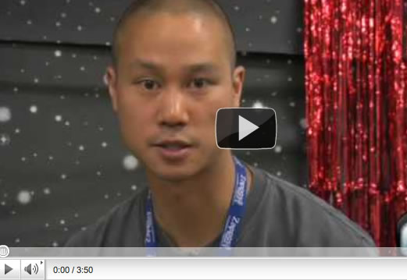
Organizational Values
http://www.youtube.com/watch?v=g6WHAfWqX3s

Slide 15
Vision and Values
How do vision and values work with the organizational elements we talked about earlier to build organizational capacity in flexible planning?
TBP

Slide 16
Evaluation
What are the key points of this module?
What did you find most useful?
What can we improve upon?
Other items you want us to cover?
TBP

Slide 17
Curriculum Modules
Module 1: Foundations for Transforming Board Practice
Module 2: Legal and Recruitment Issues
Module 3: Governance and Board Structure
Module 4: Enhancing Board Engagement
Module 5: Constructive Conflict
Module 6: Thinking Strategically
Module 7: Asking the Right Questions
Module 8: Board Meeting Communication
TBP

Slide 18
Curriculum Modules
PDF copies of the curriculum modules are available for viewing on the
NC Thrive portal: http://communitydevelopment.ces.ncsu.edu/local-government-nonprofits/
TBP

Slide 19
References
Cooperrider, D.L., Whitney, D., Stavros, J.M. (2008). Appreciative Inquiry Handbook: For Leaders of Change (2nd edition). Brunswick, Ohio: Crown Custom Publishing Inc.
For additional information, case studies, articles, materials and meeting design please visit the Appreciative Inquiry Commons at http://appreciativeinquiry.case.edu/
McNamara, C. (2007). Field Guide to Nonprofit Strategic Planning
and Facilitation (3rd edition). Minneapolis, Minnesota: Authenticity Consulting, LLC
TBP
Notes:
Add Carter McNamara cite? Others?

