Slide 2
Becky Bowen She is an attorney and has served several nonprofit organizations in various capacities, including communications director, general counsel and executive director. She currently is a Co-Director of Carolina Common Enterprise, a nonprofit cooperative and community development center.
Jessica Katz Jameson is an Associate Professor in the Department of Communication at NC State University. She teaches courses and conducts community-engaged research on the topics of organizational communication, conflict management and nonprofit leadership. She chairs the Academic Council for the Institute for Nonprofits and serves on the Extension, Engagement and Economic Development task force for the College of Humanities and Social Sciences.
Susan Scherffius Jakes is the Associate State Program Leader for Community Development, an Extension Assistant Professor with NC Cooperative Extension and an Adjunct Professor in Psychology at North Carolina State University. She received a Ph.D. in Community Psychology from North Carolina State University.
Mary Tschirhart is a Professor of Public Administration at The Ohio State University. She served as Director of the Institute for Nonprofits and Professor of Public Administration at NC State University from 2008-2013. She has published extensively on nonprofit topics including board governance. She recently co-authored a text titled Managing Nonprofit Organizations. Dr. Tschirhart has served on six nonprofit boards in a variety of roles, including president, and led a nonprofit as its executive director.

Slide 3
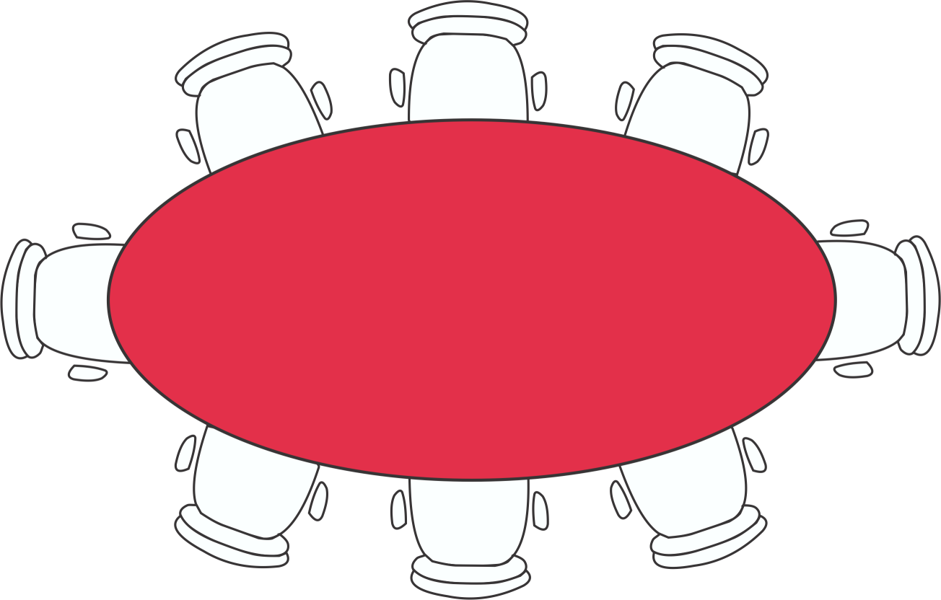
Module 5
Constructive Conflict

Slide 4
Goals for this Module
Participants should be able to:
Describe the difference between Destructive versus Constructive Conflict
Provide examples of Conflict Orientations
(Power based, Rights based, or Interest based)
Review principles of Constructive Communication
Practice Non-evaluative Listening Skills & Supportive Communication
Practice Constructive Communication
TBP

Slide 5
Destructive Conflict
Work with your group to draw a picture that represents destructive conflict.
TBP

Slide 6
Constructive Conflict
Work with your group to draw a picture that represents constructive conflict.
TBP

Slide 7
Constructive Conflict
Constructive conflict focuses on the issues through supportive dialogue that leads to understanding multiple views and collaborative problem-solving.
TBP

Slide 8
Conflict Orientations
Power-based
Rights-based
Interests-based
TBP

Slide 9
Conflict Orientations
Power-based:
Assumes the party with the most power wins. Coercive tactics such as threats and unilateral decisions are common.
TBP

Slide 10
Conflict Orientations
Rights-based:
Assumes an objective right and wrong according to some standard. Third party makes a ruling to determine appropriate remedy or resolution.
TBP

Slide 11
Conflict Orientations
Interests-based:
Assumes the interests or needs of all parties are important and a solution can be reached through collaborative processes.
TBP

Slide 12
Constructive Communication
Avoid attribution error
Focus on common goals
Use face-saving, supportive (rather than defensive) communication strategies
Avoid strong language
Encourage a culture of inquiry - don’t be afraid to ask questions
TBP

Slide 13
Face-Saving
People want to be seen as independent
People want to be liked, respected, feel they belong
We can communicate in ways that support or threaten another’s face
Face threats lead to defensiveness, the primary cause of conflict escalation
Many people avoid conflict to reduce face-threat
TBP

Slide 14
Defensive & Supportive Communication
Defensive
Evaluation
Control
Strategy
Neutrality
Superiority
Certainty
Supportive
Description
Problem orientation
Spontaneity
Empathy
Equality
Provisionalism
TBP

Slide 15
Non-evaluative Listening
(Activity)
Find a partner: The speaker will explain a current conflict or problem they are having.
Ask Questions: The listener should ask questions to help the person clarify concerns, interests, and goals. The questions must be non-judgmental and may not offer advice.
Switch roles:
After about 5 minutes switch roles.
TBP

Slide 16
Putting it all Together
Read the case scenario provided.
Take a few minutes to consider your likely position if you were on this board of directors.
What questions would you want to ask?
What information would you need?
We will role play this meeting as a group.
TBP

Slide 17
Evaluation
What are the key points of this module?
What did you find most useful?
What can we improve upon?
Other items you want us to cover?
TBP

Slide 18
Curriculum Modules
Module 1: Foundations for Transforming Board Practice
Module 2: Legal and Recruitment Issues
Module 3: Governance and Board Structure
Module 4: Enhancing Board Engagement
Module 5: Constructive Conflict
Module 6: Thinking Strategically
Module 7: Asking the Right Questions
Module 8: Board Meeting Communication
TBP

Slide 19
Curriculum Modules
PDF copies of the curriculum modules are available for viewing on the
NC Thrive portal: http://communitydevelopment.ces.ncsu.edu/local-government-nonprofits/
TBP

Slide 20
References
Gibb, J. (1961). Defensive communication. The Journal of Communication, 11( 3), 141-148. The article also appeared in ETC: A Review of General Semantics, Vol. 22, No. 2, June 1965, pp. 221-230. Reprint: http://www.healthy.net/scr/Article.asp?Id=2533
Ury, W. F., Brett, J. A., and Goldberg, S. (1988). Getting Disputes Resolved. San Francisco, CA: Jossey-Bass.
Schachter, S. (1951). Deviation, rejection and communication. Journal of Abnormal Social Psychology. 46:190-207.
TBP

